Slide 1



Module 3
DTDs

Slide 2


Module Overview
In this module, you will learn about:
Document Type Definition
Working with DTDs
Valid XML Documents
Declarations

Slide 3


Definition of a DTD
It is a non XML document made up of element,
attribute and entity declarations.
It helps XML parsers to validate the XML document.

Slide 4


Need for a DTD
XML allows a user to define his/her own tag.
Standardization of elements and attributes was needed.
A DTD can define all the possible combinations and sequences for elements.
Strucrure of DTD:
Element Declarations
Attribute Declarations
Entity Declarations

Slide 5


Creating Internal DTDs 1-2
Declare all the possible elements
Specify the permissible element children, if any
Set the order in which elements must appear
Declare all the possible element attributes
Set the attribute data types and values
Declare all the possible entities
Syntax
<!ELEMENT element-name (element-content)>
…
<!ATTLIST element-name attribute-name attribute-
type default-value>
…
<!ENTITY entity-name “entity-value”>
…

Slide 6

Creating Internal DTDs 2-2
Code Snippet
<!ELEMENT Mobile (Company, Model, Price, Accessories)>
<!ELEMENT Company (#PCDATA)>
<!ELEMENT Model (#PCDATA)>
<!ELEMENT Price (#PCDATA)>
<!ELEMENT Accessories (#PCDATA)>
<!ATTLIST Model Type CDATA “Camera”>
<!ENTITY HP “Head Phones”>
<!ENTITY CH “Charger”>
<!ENTITY SK “Starters Kit”>

Slide 7
DOCTYPE Declarations
It specifies the name of the DTD and either its content or
location.
It begins with <!DOCTYPE and ends with a >.
Syntax
<!DOCTYPE name_of_root_element [ internal DTD subset ]>
Or
<!DOCTYPE name_of_root_element SYSTEM “URL of the
external DTD subset” >

Slide 8



Types of DTDs 1-2
DTDs can be classified as Internal or External.
Internal DTDs
It consists of the DTD name followed by the DTD enclosed in square brackets.

Slide 9

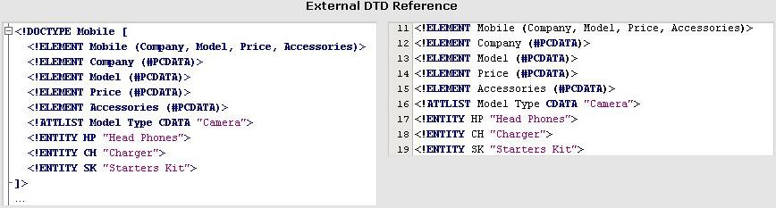
Types of DTDs 2-2
External DTDs
It consists of the DTDs name followed by the
SYSTEM keyword followed by the address

Slide 10


Well-Formed XML documents
All elements must be enclosed by the root element
All elements must have closing tags
All tags should be case sensitive
All elements must be properly nested
All attribute values must always be quoted

Slide 11


Valid XML documents 1-2
A valid XML document is a well-formed XML
document that adheres to its DTD.
The validity of an XML document is determined by checking it against its DTD.

Slide 12


Valid XML documents 2-2
Code Snippet
<?xml version=”1.0” encoding=”ISO-8859-1”?>
<!DOCTYPE Mail [
<!ELEMENT Mail (To, From, Date, Time, Cc, Bcc, Subject, Message, Signatu re)>
<!ELEMENT To (#PCDATA)>
<!ELEMENT From (#PCDATA)>
<!ELEMENT Date (#PCDATA)>
<!ELEMENT Time (#PCDATA)>
<!ELEMENT Cc (#PCDATA)>
<!ELEMENT Bcc (#PCDATA)>
<!ELEMENT Subject (#PCDATA)>
<!ELEMENT Message (#PCDATA)>
<!ELEMENT Signature (#PCDATA)>
]>
<Mail>
<To> anne@xyz.com </To>
<From> bob@xyz.com </From>
<Date> 27th February 2007 </Date>
<Time> 11:30 am </Time>
<Cc> </Cc>
<Bcc> </Bcc>
<Subject> Meeting at Main Conference Room at 4:30pm </Subject>
<Message> Hi, Kindly request you to attend the cultural body general meeting in the main conference room at 4:30 pm. Please be present to learn about the new activities being planned for the employees for this year. Yours sincerely, Bob
</Message>
<Signature> </Signature>
</Mail>

Slide 13

Testing XML for Validity 1-2
It can be determined by using a validating parser such as Microsoft XML Core Services (MSXML) 6.0 Parser.
MSXML enables the Internet Explorer (IE) browser to validate the code.
The first image displays the validation result of a valid mobile.xml file.
The second image displays the validation result after the removal of the signature element.

Slide 14


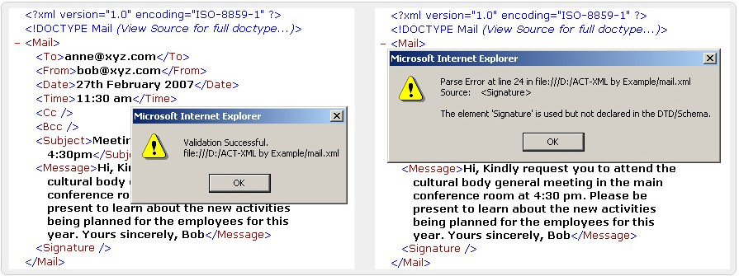
Testing XML for Validity 2-2

Slide 15

Declaring Elements
XML elements are declared with an element declaration.
Syntax
<!ELEMENT element-name element-rule>
where,
ELEMENT is the keyword,
element-name is the name of the element,
element-rule can be one of the following: No Content, Only
Parsed Character Data, Any Contents, Children, Only One Occurrence, Minimum One Occurrence, Zero or More Occurrences, Zero or One Occurrence, Either/Or Content or Mixed Content

Slide 16
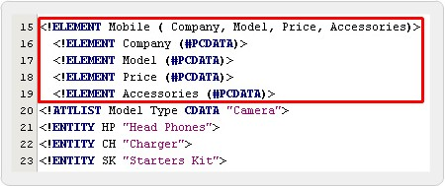
Testing XML for Validity

Slide 17
Declaring Attributes 1-2
Syntax
<!ATTLIST element-name attribute-name attribute- type default-value>
where,
element-name is the element the attribute belongs
attribute-name is the name of the attribute attribute-type is type of data the attribute can accept default-value is the default value for the attribute

Slide 18
Declaring Attributes 2-2
Value | Description
PCDATA | Parsed character data
CDATA | Character data
(en1|en2|..) | Enumerated list
ID | A unique id
IDREF | Id of another element
IDREFS | List of other ids
NMTOKEN | Valid XML name
NMTOKENS | List of valid XML names
ENTITY | An entity
ENTITIES | List of entities
NOTATION | Name of a notation
xml: | Predefined xml value

Slide 19
Specifying Attribute Values 1-3
Value | Description
value | Default value
#REQUIRED | Value must be included
#IMPLIED | Value does not have to be included
#FIXED | Value is fixed
en1|en2|... | Listed enumerated values

Slide 20

Specifying Attribute Values 2-3
Syntax
#IMPLIED
<!ATTLIST element-name attribute-name attribute-
type #IMPLIED>
#REQUIRED
<!ATTLIST element-name attribute-name attribute-
type #REQUIRED>
#FIXED
<!ATTLIST element-name attribute-name attribute-
type #FIXED “value”>
Enumerated Attribute Values
<!ATTLIST element-name attribute-name
(en1|en2|..) default-value>
<!ATTLIST payment type (check|cash) “cash”>

Slide 21


Specifying Attribute Values 3-3
Code Snippet
Default Value
<!ATTLIST Model Type CDATA “Camera”>
#IMPLIED
<!ATTLIST Model Type CDATA “Camera” #IMPLIED>
#REQUIRED
<!ATTLIST Model Type CDATA #REQUIRED>
#FIXED
<!ATTLIST Model Type CDATA #FIXED “Camera”>
Enumerated Attribute Values
<!ATTLIST Model Type (Camera|Bluetooth) “Camera”>

Slide 22
Entities in DTD 1-2
It is a placeholder that consists of a name and a value.
It is declared once and then repeatedly used through out the document.
Syntax
Entity declaration:
<!ENTITY entity-name “entity-value”>
Entity Reference:
&entity-name;

Slide 23
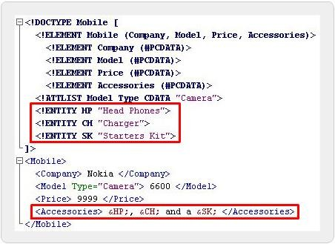
Entities in DTD 2-2
Code Snippet

Slide 24
Kinds of Entity Declarations 1-4
Internal Entity Declaration
The entity value is explicitly mentioned in the entity declaration.
Syntax
<!ENTITY entity-name “entity-value”>

Slide 25


Kinds of Entity Declarations 2-4
Code Snippet
<!DOCTYPE Mobile [
<!ELEMENT Mobile (Company, Model, Price, Accessories)>
<!ELEMENT Company (#PCDATA)>
<!ELEMENT Model (#PCDATA)>
<!ELEMENT Price (#PCDATA)>
<!ELEMENT Accessories (#PCDATA)>
<!ATTLIST Model Type CDATA “Camera”>
<!ENTITY HP “Head Phones”>
<!ENTITY CH “Charger”>
<!ENTITY SK “Starters Kit”>
]>
<Mobile>
<Company> Nokia </Company>
<Model Type=”Camera”> 6600 </Model>
<Price> 9999 </Price>
<Accessories> &HP;, &CH; and a &SK; </Accessories>
</Mobile>

Slide 26


Kinds of Entity Declarations 3-4
External Entity Declaration
A link or path to the entity value is mentioned in place of the entity value

Slide 27


Kinds of Entity Declarations 4-4
Syntax
<!ENTITY entity-name SYSTEM “URI/URL”>
<!DOCTYPE Mobile [
<!ELEMENT Mobile (Company, Model, Price, Accessories)>
<!ELEMENT Company (#PCDATA)>
<!ELEMENT Model (#PCDATA)>
<!ELEMENT Price (#PCDATA)>
<!ELEMENT Accessories (#PCDATA)>
<!ATTLIST Model Type CDATA “Camera”>
<!ENTITY HP SYSTEM “hp.txt”>
<!ENTITY CH SYSTEM “ch.txt”>
<!ENTITY SK SYSTEM “sk.txt”>
]>
<Mobile>
<Company> Nokia </Company>
<Model Type=”Camera”> 6600 </Model>
<Price> 9999 </Price>
<Accessories> &HP;, &CH; and a &SK; </Accessories>
</Mobile>
hp.txt
Head Phones ch.txt Charger sk.txt Starters Kit

Slide 28


Summary 1-2
Document Type Definition
A DTD is a non XML document made up of element, attribute and entity declarations.
Working with DTDs
The DTD structure is composed of element declarations, attribute declarations, and entity declarations.
A document type declaration declares that the XML file in which it is present adheres to a certain DTD.

Slide 29

Summary 2-2
Valid XML Documents
A well-formed XML document adheres to the basic XML syntax rules.
A valid XML document is a well-formed XML document that adheres to its DTD.
Declarations
XML elements are declared with an element declaration in the DTD.
An entity is a placeholder that consists of a name and a value.

